Slide 1
Python Programming Lab
By
K.SRAVAN
Assistant Professor
Dept. of CSE
GRIET

Slide 2
Syllabus
TASK 1(Control Statements & Lists)
Write a python program to find factorial of a given number.
Write a Python program to find GCD of two numbers.
Write a Python program that reads a list of names and ages, then prints the list sorted by age.
TASK 2(Tuples & Dictionaries)
Write a program to demonstrate working with tuples in python.
Write a program to demonstrate working with dictionaries in python.
TASK 3(Files)
Write a Python program that will prompt the user for a file name, read all the lines from the file into a list, sort the list, and then print the lines in sorted order.
Write a Python program that asks the user for a filename,andthenprints thenumberofcharacters,words,andlinesinthefile.

Slide 3
TASK 4(Exception Handling)
Write a python program to create user defined exception.
Write a program to demonstrate ‘finally’ keyword in python.
TASK 5(Lamda function)
Write a Python program to create a lambda function that adds 15 to a given number passed in as an argument, also create a lambda function that multiplies argument x with argument y and print the result.
Write a Python program to square and cube every number in a given list of integers using Lambda.
TASK 6 (Modules)
Write a Python program to shuffle the elements of a given list
Write a Python program to read and display the content of a given CSV file

Slide 4
TASK 7(Classes)
Create a class Rectangle. The constructor for this class should take two numeric arguments, which are the length and breadth. Add methods to compute the area and perimeter of the rectangle, as well as methods that simply return the length and breadth. Add a method ‘isSquare’ that returns a Boolean value if the Rectangle is a Square.
Write a class Complex for performing arithmetic with complex numbers. The constructor for this class should take two floating-point values. Add methods for adding, subtracting, and multiplying two complex numbers.
TASK 8 (Multithreading)
Write a program to demonstrate working with multiple threads in python.
Write a python program to illustrate synchronization in multithreading.

Slide 5
TASK 9 (GUI Applications)
Write a Python program that works as a simple calculator. Use a grid to arrange buttons for the digits and for the +, -,*, % operations. Add a text field to display the result.
Develop a Python GUI application that receives an integer in one text field, and computes its factorial Value and fills it in another text field, when the button named “Compute” is clicked.

Slide 6
TASK 10 (GUI Applications)
Write a Python program that creates a user interface to perform integer divisions. The user enters two numbers in the text fields, Num1 and Num2. The division of Num1 and Num2 is displayed in the Result field when the Divide button is clicked. If Num1 or Num2 were not an integer Num2 is Zero, the program should Display an appropriate message in the result field in Red color.
Write a Python program that simulates a traffic light. The program lets the user select one of three lights: red, yellow, or green. When a radio button is selected, the light is turned on, and only one light can be on at a time.No light is on when the program starts

Slide 7
TASK 11(Django Framework)
Create a Django web application for a simple calculator with basic operations (+, -, * and /) with two numbers.
Create a Django web application that implements Library MIS, which has the features like
Add/Delete a book
Issue a book to a person
Collect a book from a person
Search for a title or author
TASK 12(Django Framework)
Create a Django web application that implements a bus reservation system, where a new bus can be added/removed with a given source and destination. A user should be able to reserve or cancel a seat.

Slide 8
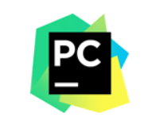
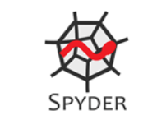
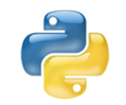


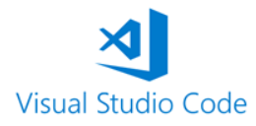
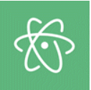
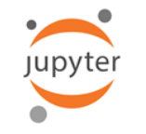
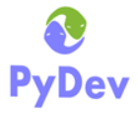

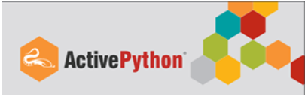
Different Python IDEs:

Slide 9
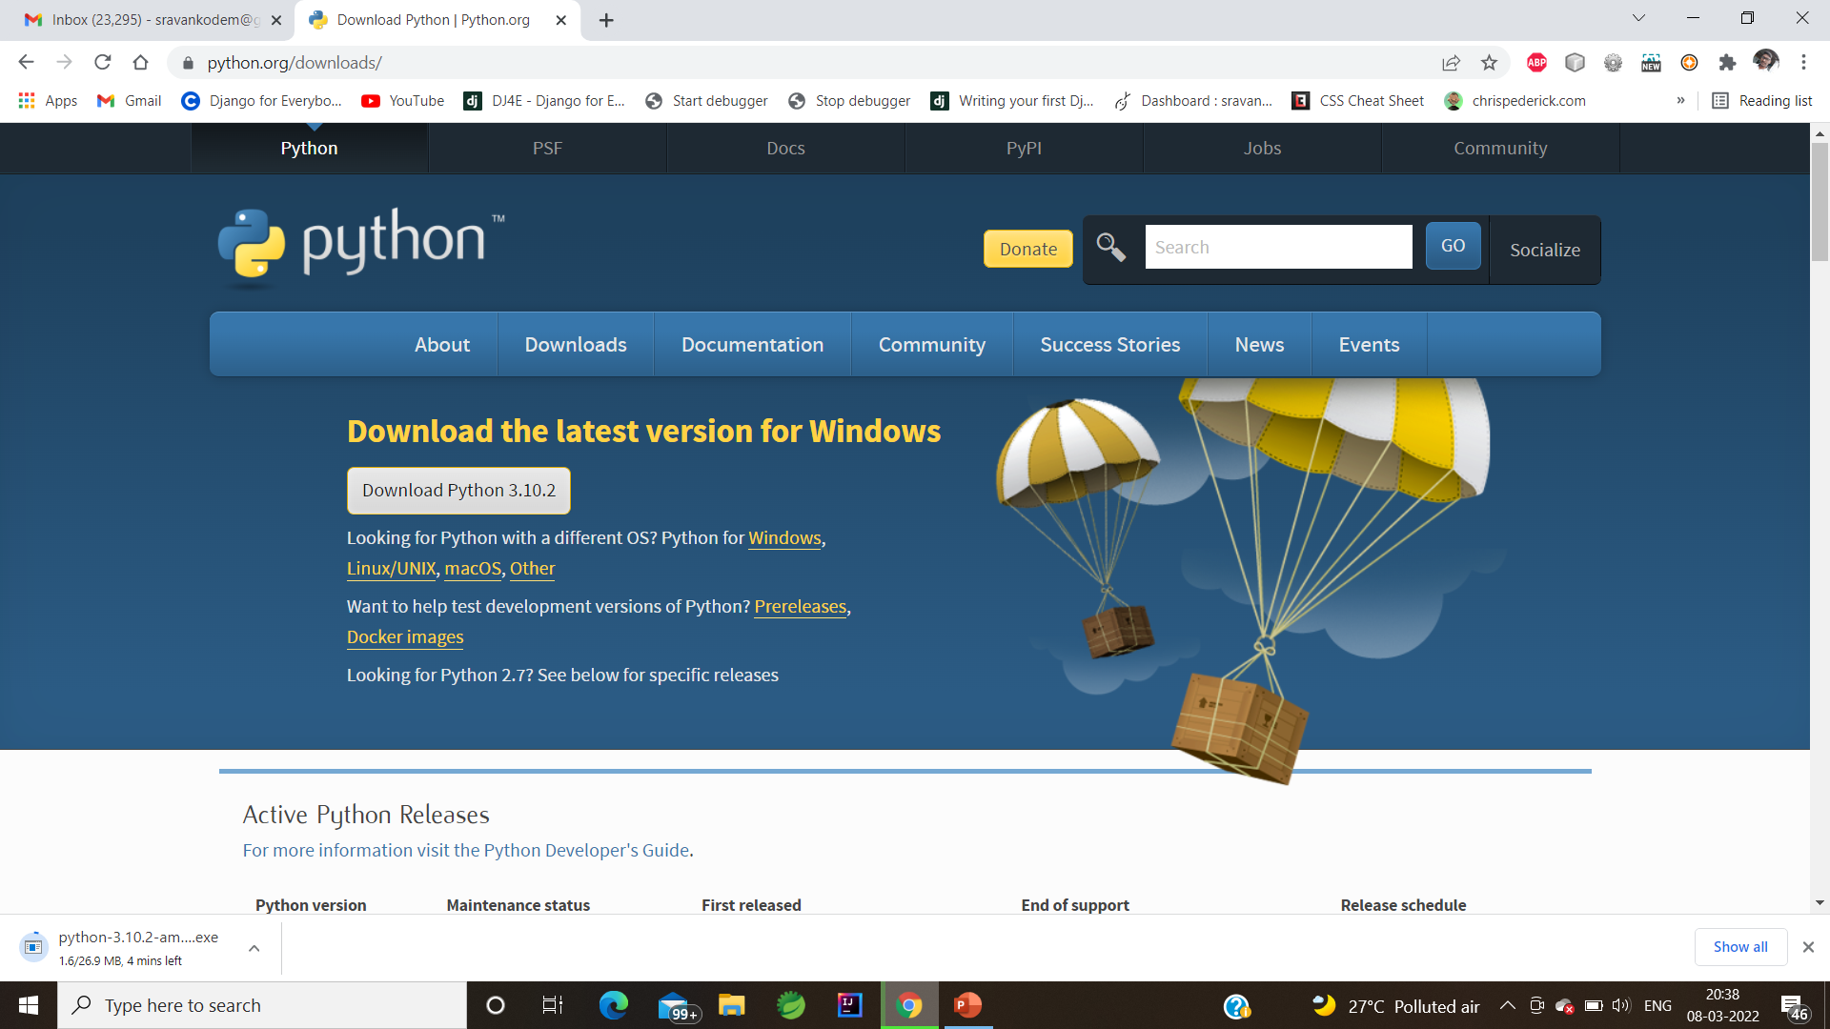
Installing Python:
GO to the following site and download python

Slide 10
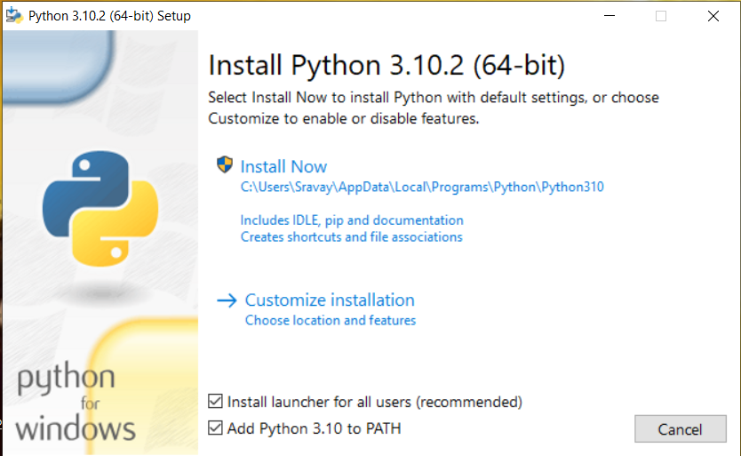

Slide 11
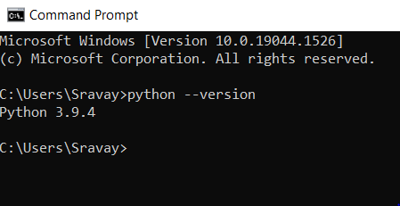
To know the version of a Python that you installed type the following command
>python --version

Slide 12
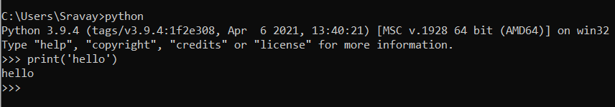
Running Python
There are three different ways to start Python:
1. Interactive Interpreter: You can start Python from Unix, DOS, or any other system that provides you a command-line interpreter or shell window.
Enter python the command line. Start coding right away in the interactive interpreter

Slide 13

2 Script from the Command-line: A Python script can be executed at command line by invoking the interpreter on your application, as in the following:
$python script.py

Slide 14
3 Integrated Development Environment (IDEs)
You can run Python from a Graphical User Interface GUI environment as well, if you have a GUI application on your system that supports Python.
Unix: IDLE is the very first Unix IDE for Python.
Windows: PythonWin is the first Windows interface for Python and is an IDE with a GUI.

